Slide 1
18-349: Introduction to Embedded Real-Time Systems Lecture 1: Overview
Anthony Rowe
Electrical and Computer Engineering
Carnegie Mellon University

Slide 2
What is an embedded system?

Slide 3
An introduction
Computer system hidden (embedded) in other systems
Often interacts with the physical environment
Purpose built
End users see “smart” device rather then computer
Special-purpose vs. general-purpose computing

Slide 4
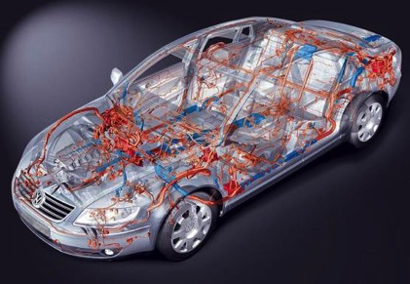
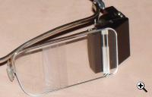
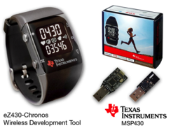
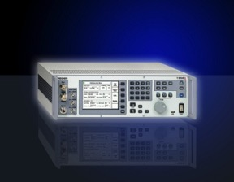
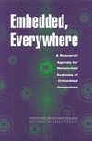
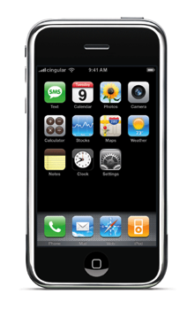
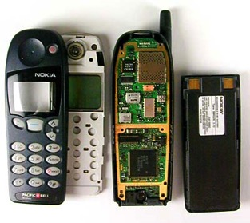
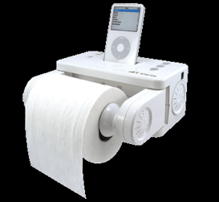
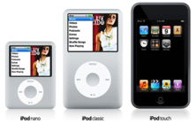
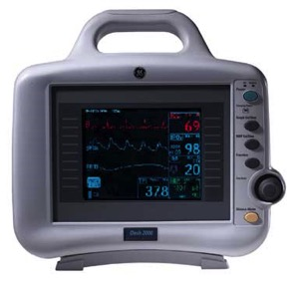
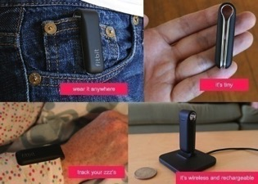
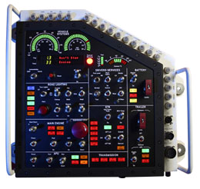
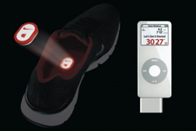
Embedded, Everywhere

Slide 5
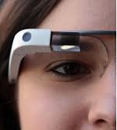

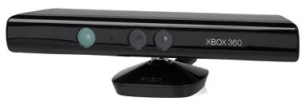
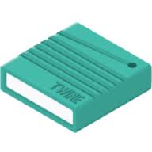
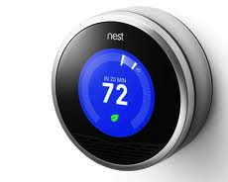
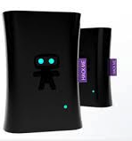


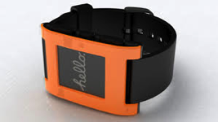
Embedded, Everywhere – Internet of Things
People Connecting
Through Machines
Machines Connecting to Machines
and the Physical Environment

Slide 6
Embedded in Your Daily Life
How many micro-controllers are around you?
Bathroom scale with digital read out
Iron that turns itself off automatically
Electronic toothbrush (with ~3000 lines of code)
Cooking range
Laundry machine and dryer
Toaster
Microwave
Home-security
TV, cable-box, AV system
Game console
Thermostat
Cars, Toys, Medical Devices…
Notes:
Furby has a more powerful CPU then original mars lander

Slide 7
What is driving the embedded explosion?

Slide 8
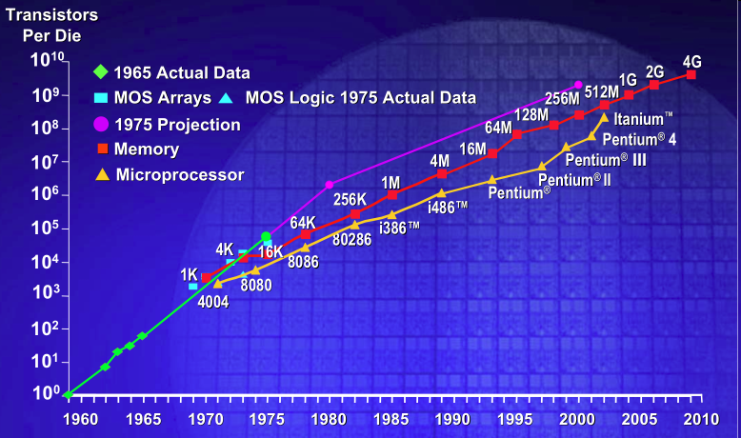
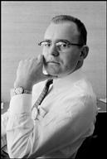
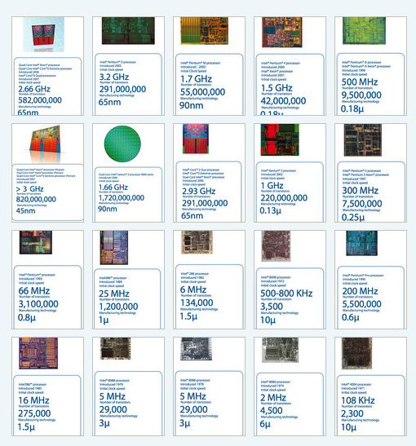
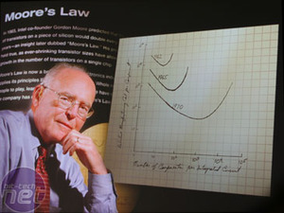
Moore’s Law (a statement about economics): IC transistor count doubles every 18-24 mo
Photo Credit: Intel

Slide 9
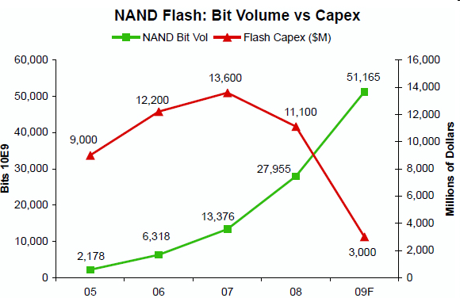
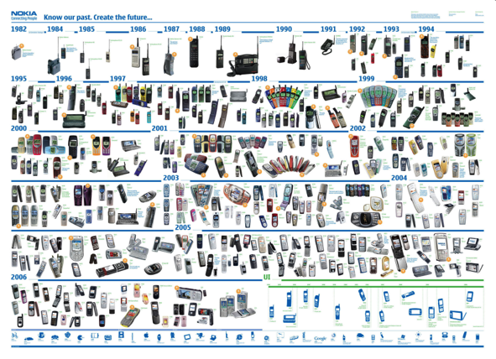
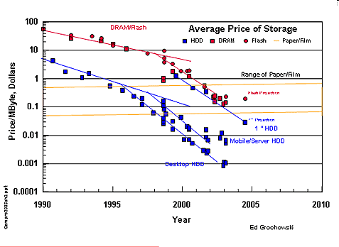
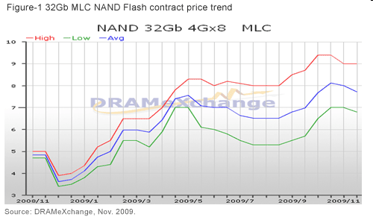
Flash memory scaling: Rise of density & volumes; Fall (and rise) of prices

Slide 10
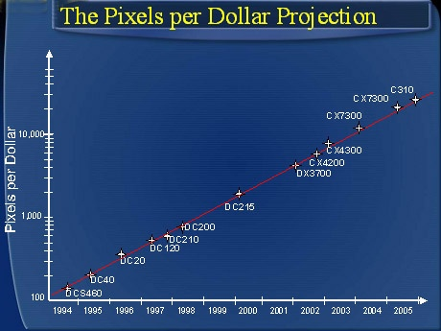

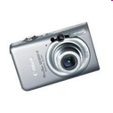
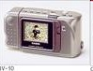
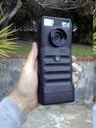
Hendy’s “Law”: Pixels per dollar doubles annually
Credit: Barry Hendy/Wikipedia

Slide 11
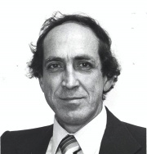
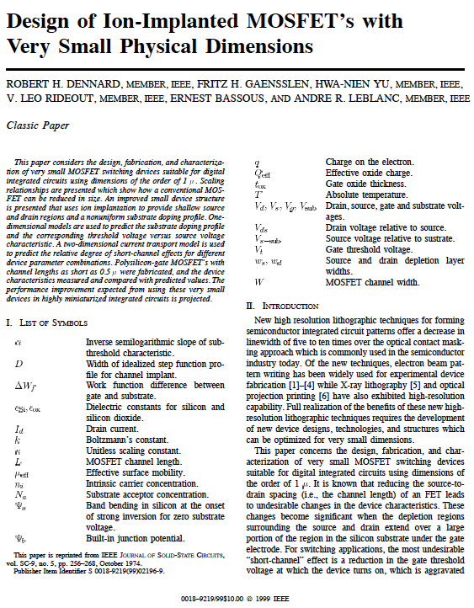
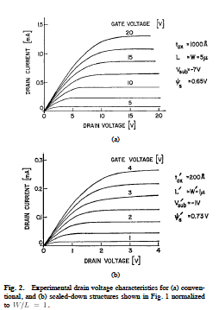
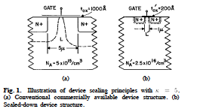
Dennard Scaling made transistors fast and low-power: So everything got better!
Notes:
As transistors get smaller, their power density stays the same, so the power use stays in proportion to area…

Slide 12
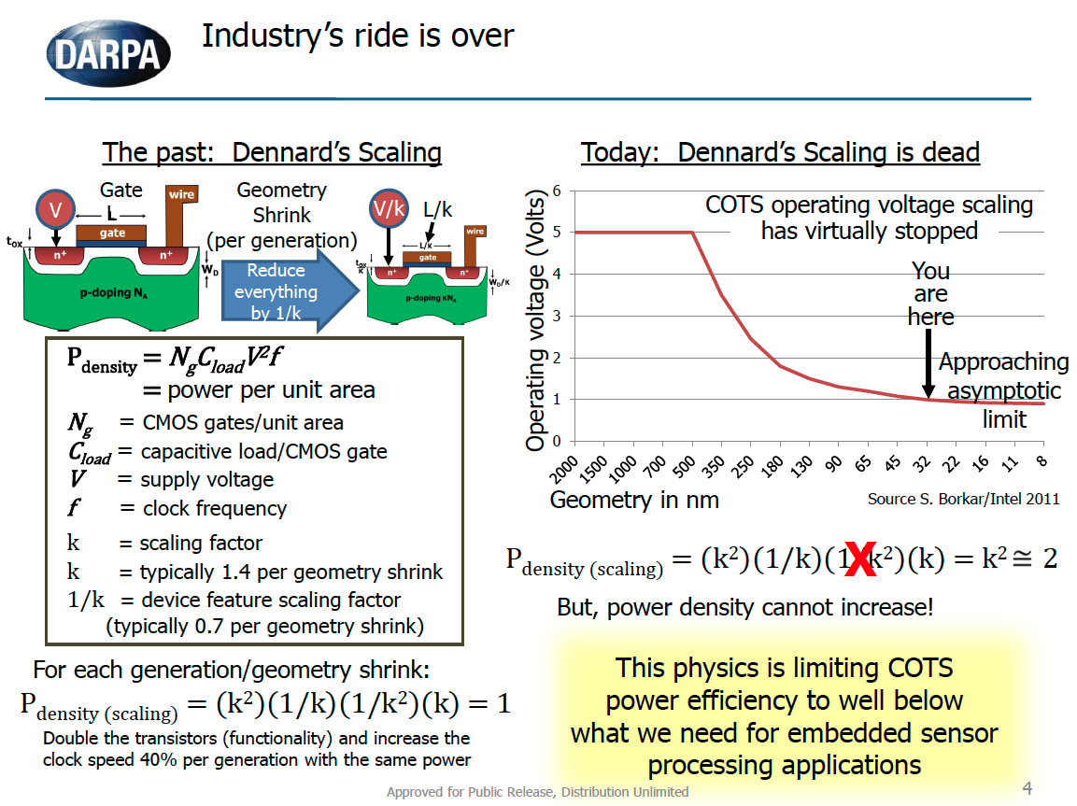
Source: Joe Cross, DARPA MTO

Slide 13
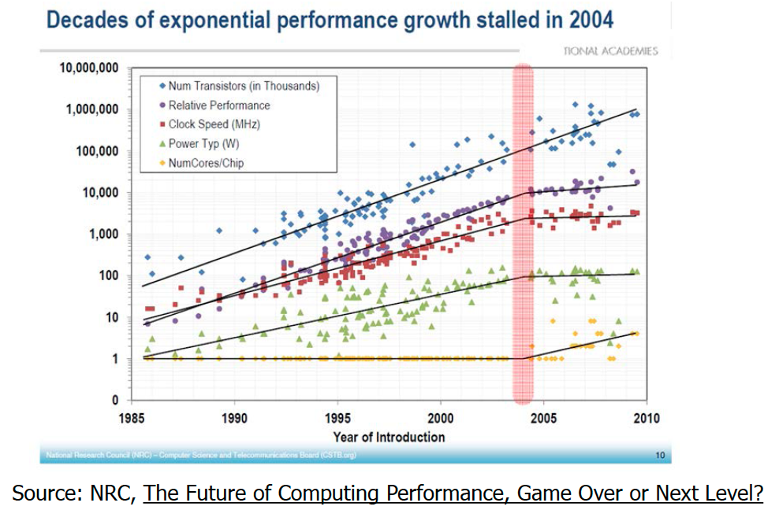

Slide 14
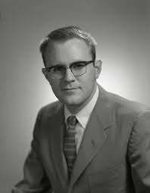
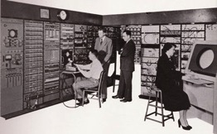
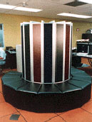
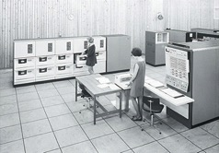
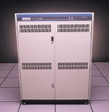
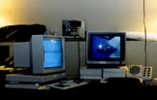
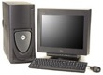
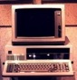
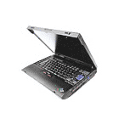
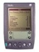
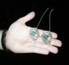
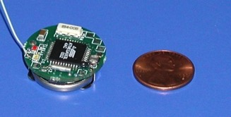
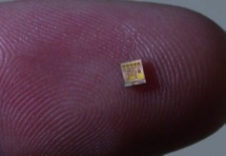

Not so fast! Bell’s Law of Computer Classes: A new computing class roughly every decade
Number Crunching
Data Storage
Mainframe
log (people per computer)
Minicomputer
productivity
interactive
Workstation
PC
Streaming information
to/from physical world
Laptop
CPSD
year
“Roughly every decade a new, lower priced computer class forms based on a new programming platform, network, and interface resulting in new usage and the establishment of a new industry.”
Credit: D. Culler
Notes:
So if we look at the computing spectrum today, each of the classes exist simultaneously. In a room we can put 100s of teraflops and many petabytes of computing.
Our productivity, document preparation, and personal information management fits in our pocket and a new class is emerging that will provide a means of streaming information to and from the physical world like we have never seen before.

Slide 15
Technology Trends
Multi-core embedded with SoC
Better, cheaper, lower power sensors
Better communication
Bluetooth Low-Energy
802.15.4
802.11 AC
Energy Harvesting

Slide 16
Why is embedded different?

Slide 17



Typical Embedded System Challenges (1-2)
Small Size, Low Weight
Hand­held electronics
Transportation applications ­­ weight costs money
Low Power
Battery power for 8+ hours (laptops often last only 2 hours)
Limited cooling may limit power even if AC power available

Slide 18


Typical Embedded System Challenges (2-2)
Harsh environment
Heat, vibration, shock
Power fluctuations, RF interference, lightning
Water, corrosion, physical abuse
Safety-critical operation
Must function correctly
Must not function incorrectly
Extreme cost sensitivity
$.05 adds up over 1,000,000 units

Slide 19
CPU: An All­ Too ­Common View of Computing
Measured by: Performance
CPU

Slide 20
An Advanced Computer Engineer's View
Measured by: Performance
Compilers matter too...
Cache
Memory
CPU

Slide 21
An Enlightened Computer Engineer's View
Measured by: Performance, Cost
Compilers & OS matter
Cache
Memory
CPU
I/O

Slide 22
An Embedded Computer Designer's View
Measured by: Cost, I/O connections, Memory Size, Performance
Memory
Cache
Microcontroller
A/D
CPU
D/A
MMI
I/O

Slide 23
An Embedded Application Designer's View
Measured by: Cost, Time­to­market, Cost, Functionality, Cost & Cost.
Memory
Cache
Microcontroller
Sensors
A/D
CPU
D/A
Actuator
Diagnostic
tools
MMI
I/O
Auxiliary Systems
(power, cooling)
Electro-mechanical
backup and safety
External
Environment

Slide 24
Modern Embedded Systems View
Measured by: Does it actually work? (and all of the other stuff)
Memory
Network
Cache
Microcontroller
Sensors
A/D
CPU
D/A
Actuator
Distributed!
Diagnostic
tools
MMI
I/O
Auxiliary Systems
(power, cooling)
Electro-mechanical
backup and safety
External
Environment
Memory
Memory
Network
Cache
Microcontroller
Network
Cache
CPU
Microcontroller
Sensors
A/D
D/A
Actuator
Sensors
A/D
CPU
D/A
Actuator
Diagnostic
tools
MMI
I/O
Auxiliary Systems
(power, cooling)
Diagnostic
tools
Auxiliary Systems
(power, cooling)
MMI
I/O
Electro-mechanical
backup and safety
Electro-mechanical
backup and safety
External
Environment
External
Environment

Slide 25
Embedded Computers Rule the Marketplace
~80 Million PCs vs. ~3 Billion Embedded CPUs annually
Embedded market growing; PC market mostly saturated
Domain Experts Needed…
General Computing
Set-top boxes, video game consoles, ATM, …
Control Systems
Airplane, Heating and Cooling System
Signal Processing
Radar, Sonar, Video Compression, Human-Brain interface
Communication
Internet, Wireless Communication, VoIP…

Slide 26




















Embedded Systems Careers

Slide 27

Misconceptions (1)
Embedded systems = low end microcontrollers

Slide 28
Misconceptions (2)
Embedded system programing = programming in assembly to optimize the code for space, time etc.
Compilers are typically better then humans at generating the best code
Code portability issues -> some device-driver dependent code written in assembly, but most app code is written in higher-level languages

Slide 29
Misconceptions (3)
Embedded systems = old topic
Always new and exciting developments that track technology
New sensors / actuators
More powerful chips
New communication mechanisms
Embedded systems + Internet = Internet of Things
Massively hot topic right now!

